Slide 1


Constructing case study data for Electronic Health records (EHR) and assessing the usability of data entry into an EHR
The Harmony Squad
Alekhya Guttikonda
Anitha Mulumudi
Sri Harshini Peddi
Neetu Mahendraker

Slide 2
CONTENTS
INTRODUCTION
PURPOSE
METHODS
DISCUSSION
RESULTS
CONCLUSION
REFERENCES

Slide 3
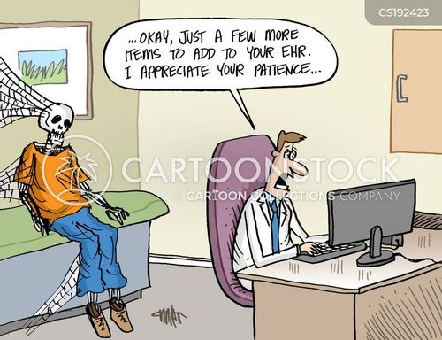
Introduction
Usability plays a vital role in the effectiveness of a product or system, as it directly influences the user's experience and overall satisfaction.
Designing Electronic Health Records (EHRs) without considering usability creates immense cognitive stress on healthcare professionals, aggravates users, and increases the possibility of user errors.
This condition not only affects clinical workflow effectiveness, but it also has serious implications for job satisfaction and, most importantly, patient care and safety.
The consequences of inadequate EHR usability go beyond user inconvenience in the demanding healthcare environment, affecting the quality and reliability of healthcare services, emphasizing the importance of user-centered design in EHR development. (Horsky et al., 2018, p.1213).
https://www.cartoonstock.com/cartoon?searchID=CS192423

Slide 4
Introduction: Case Study based on personal clinical experience.
The selected case involves a patient who is a 45-year-old Hispanic English-speaking male with a known history of type 2 diabetes (ICD10:E08.9).
The patient sustained a fall on 10/4/2023, which resulted in an injury to his left leg.
Patient came to the emergency department (ED) with pain and a swollen left leg. On arrival to ED, he had elevated blood pressure of 160/80 mm Hg and a heart rate of 110/min.
X-ray confirmed a non-displaced left Femur fracture (ICD10:S72.002A). He was evaluated by the Orthopedics team in ED who recommended non-operative management.
He was recommended braces and pain control with oral Tramadol. The patient’s pain responded well with 2 doses of Tramadol 50mg.
The patient was advised to be non-weight-bearing on the left leg and discharged home.
The patient was asked to follow up with Orthopedics in 1 week, on 10/11/2023, for the reassessment of his left Femur fracture

Slide 5
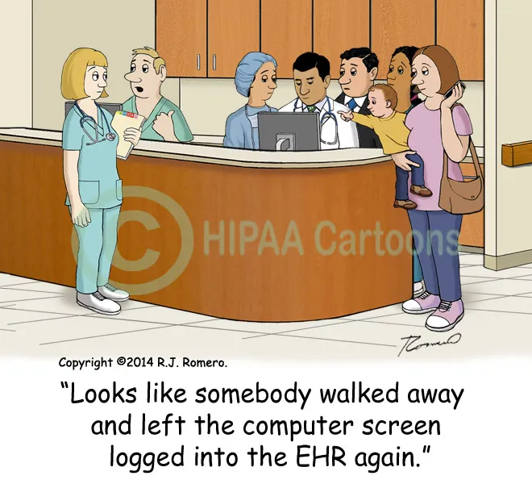
Purpose of Study:
The purpose of this study is to evaluate the usability of the EHR system, Open EMR, with a particular focus on our chosen case study.
Our objectives include understanding the workflows within Open EMR in the context of our case study, analyzing the usability of the EHR system in this specific scenario, identifying potential usability issues that may arise, and ultimately providing recommendations for improving the EHR system's usability within our case study context.
To achieve these goals, we generated four case studies involving four different patients, performing 24 tasks to comprehensively assess usability issues, particularly focusing on time-consuming tasks and other challenges encountered during the completion of various activities.
Our aim is to develop effective solutions for the usability problems identified in the EHR system within the context of our case study.
https://i0.wp.com/www.hipaacartoons.com/wp-content/uploads/2017/03/Cartoon_computer_left_logged_on_people_snooping_EHR_emr154.jpg

Slide 6
METHODS:
Performing Tasks:
24 (T1-T24) tasks were provided to be executed in an EMR system for 4 patients
An Open EMR platform was used to perform the tasks.
All the team members performed the tasks given using an Open EMR tutorial that was provided at the beginning of this study.
Each team member generated clinical data for one patient.
We used ICD-10 codes for the diagnosis and treatment of misadventures.
To create the 4 test cases in addition to our clinician's input and personal experience on our team, we used online platforms like "UpToDate" and "Medscape" to get further information about medication, timing, and dosages.

Slide 7
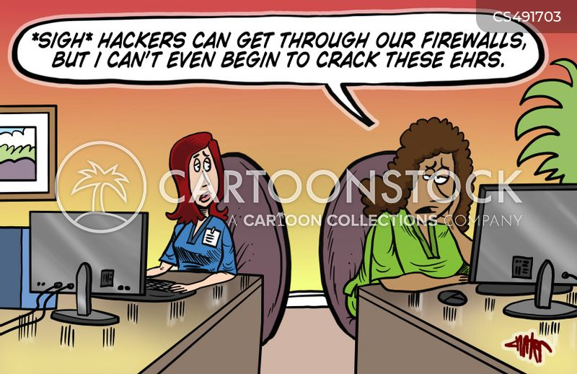
METHODS(contd.)
Measuring Usability:
We measured the time taken to perform each task as a measure for usability
We rated each task on complexity using the usability rubric that was provided
We recorded functionality limitations in the Open EMR while performing tasks
We identified workflow-related issues in Open EMR while performing tasks.
https://www.cartoonstock.com/cartoon?searchID=CS491703

Slide 8
Assigned tasks explored during this study:
T12 | Weight in pounds, patient age
T13 | vital signs-blood pressure
T14 | Heart rate
T15 | Temperature
T16 | Diagnosis
T17 | Create prescription
T18 | ICD-10 code
T19 | Add Misadventure
T20 | Misadventure injury
T21 | ICD code for, misadventure
T22 | Review of systems
T23 | Medication to treat, dosage
T24 | Follow up care
T1 | Patient
T2 | address, including street
T3 | city
T4 | state
T5 | zip code
T6 | Date of birth
T7 | Gender identity
T8 | Sexual orientation, Marital status
T9 | Language
T10 | Race
T11 | height

Slide 9
Discussion
Our project shows that usability testing for open EMR can be effectively performed using case studies. However, our study only focused on tasks T1-T24 and if there were issues relevant to other tasks, we could not identify them as it was beyond the scope of our study.
Also, we generated case studies based on our clinical experience along with a literature search, and it may be possible that the real-world case scenarios are more complex than these case studies and we cannot comment on usability issues on other complex cases.
Our project was limited to 4 case studies, and to assess its generalizability, input from larger case studies is warranted.
Our project may also be limited by measurement bias as were involved in generating the data and also measuring the effect of it on the usability in open EMR usability.
Open EMR tutorial needs enhanced guidelines so that novice EMR users can navigate the system effectively, ensuring proper data organization and accurate patient care. For example, it should mention that "Remember to create new encounter before adding vitals or other patient data, as this is a crucial step in the workflow."

Slide 10
RESULTS
Only 3 tabs are allowed, which has limited our ability to comprehensively collect data at a given point of time on a patient.
Once an encounter was created, there was no option to delete it, and that was not optimal as it can provide conflicting data to a clinician.
When vital signs are updated, it does not give an option to review/compare previous vital signs.
When medical problems or prescriptions are added, it does not have a delete option when entered in error. It only allows us to flag that it was entered in error.
We were unable to add the clinic name and/or physician name for a follow-up encounter after ED visit. This is important as it will help us understand if the encounter needs to be a new patient visit vs an established patient visit.

Slide 11
Results So Far
We were able to generate 4 case studies in open EMR.
We were able to accomplish tasks T1-24 with variable efforts.
We liked the fact the EMR auto-populates the metrics like weight in pounds/kg and temperature in Celsius/Fahrenheit.
It provided a link for educational instructions about medications and does not require us to find this information from another resources.
Open EMR displays both strengths and limitations.
Addressing these limitations is essential to optimize usability and support for healthcare professionals in delivering high-quality care.

Slide 12
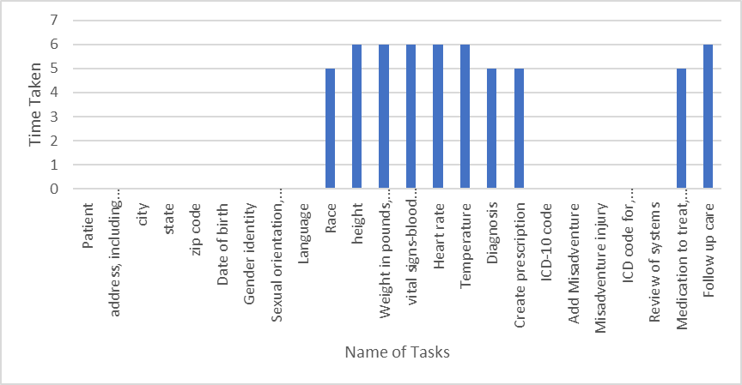
Results So Far

Slide 13
Conclusion
Overall, open EMR is an effective resource for patient management.
Open EMR is user friendly but may need further upgrades based on larger case studies and feedback.
Larger randomized clinical trials may be needed prior to the implementation of open EMR in the real clinical world.
We identified functionality limitations within Open EMR, such as the inability to delete encounters or review/compare previous vital signs, and the lack of a delete option for medical problems or prescriptions entered in error.

Slide 14
Conclusion (contd.)
Recognizing the preceding considerations, "The Harmony Squad" has chosen to take proactive measures to gain an understanding of using the Open EMR and any potential future EMRs. Our plan of action for the future is as follows:
We will conduct additional case studies with a broader range of tasks to further assess Open EMR's usability in various clinical contexts.
We aim to practice tasks consistently across a broad spectrum of situations and scenarios.
We will seek to become more conscious of areas where improvement is needed.
We will try to complete the tasks independently without the need of external guidance or support.
Through the implementation of these steps, we may actively contribute to the continuing enhancement of Open EMR's usability and efficacy in facilitating the work of healthcare professionals in performing their daily duties.

Slide 15
References:
OpenEMR. (n.d.). Support OpenEMR, give today. https://www.open-emr.org/
UpToDate. (n.d.). Metformin (Drug Information).
https://www.uptodate.com/contents/metformin-drug-information?search=metformin&source=panel_search_result&selectedTitle=1~148&usage_type=panel&kp_tab=drug_general&display_rank=1
UpToDate. (n.d.). Trazodone (Drug Information).
https://www.uptodate.com/contents/trazodone-drug-information?search=trazodone&source=panel_search_result&selectedTitle=1~80&usage_type=panel&kp_tab=drug_general&display_rank=1
Horsky, J., Schiff, G. D., Johnston, D., Mercincavage, L., Bell, D., & Middleton, B. (2012). Interface design principles for usable decision support: A targeted review of best practices for clinical prescribing interventions. Journal of Biomedical Informatics, 45(6), 1202–1216. https://doi.org/10.1016/j.jbi.2012.09.002

Slide 16
Thank You " The Harmony Squad"

